Slide 1

Rick Nichols
Data Analysis Portfolio

Slide 2
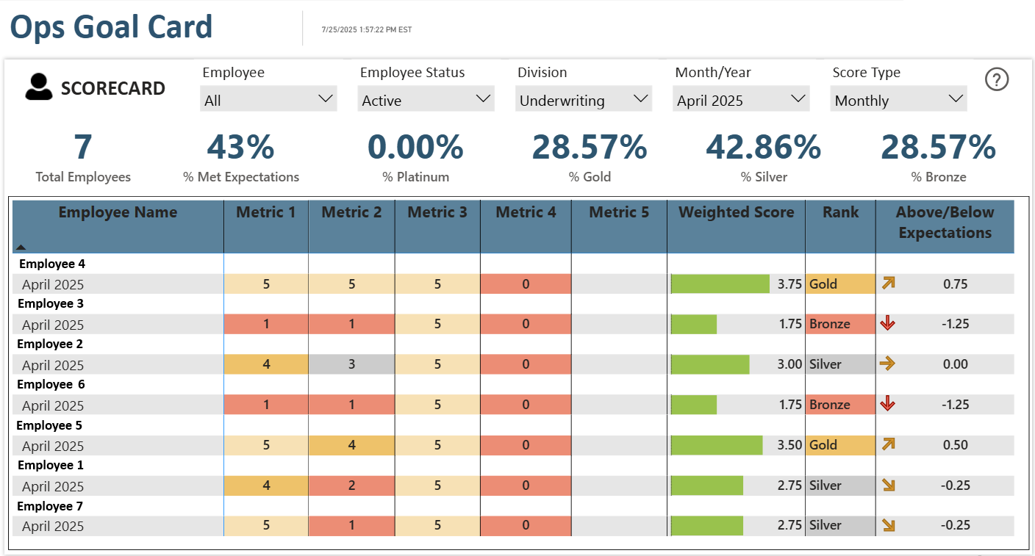
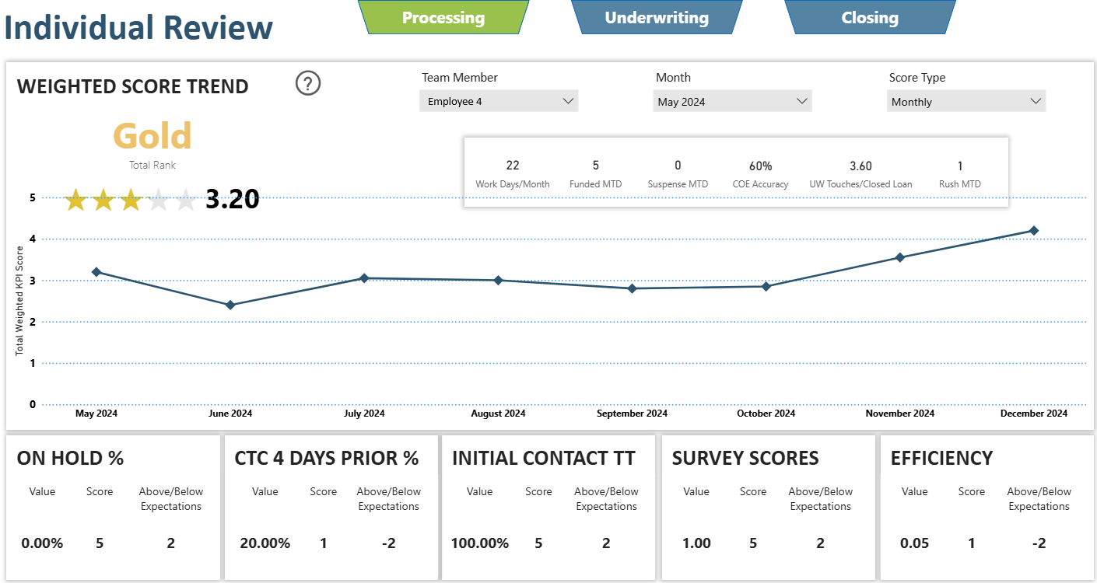
Operations Goal Card
Business Need: Department managers needed a way to measure their employee’s monthly and year-to-date performance across several metrics and measure them against expectations. An overall view and a deeper look at individuals.
Execution: I wrote a series of robust SQL functions and procedures to capture production data from the LOS, payroll data, and 3rd party quality check data, looping through and grouping by department employees given a date parameter. I configured the existing ETL to run the stored procedures daily, keeping the report current without manual intervention. I then designed the pages of the report to start with an overall view, showing all employees in the department in a matrix and some overall statistics, and a closer look at individuals over time. Also included (not pictured) is a deeper drill in to the data from the LOS and other systems for employee reviews quality checks.
Impact: This automated reporting solution empowered department managers with timely, accurate, and granular performance data, enabling them to effectively coach employees, conduct data-driven reviews, and align individual output with departmental goals. By providing both macro and micro views, the dashboard significantly improved operational oversight and efficiency in performance management.

Slide 3
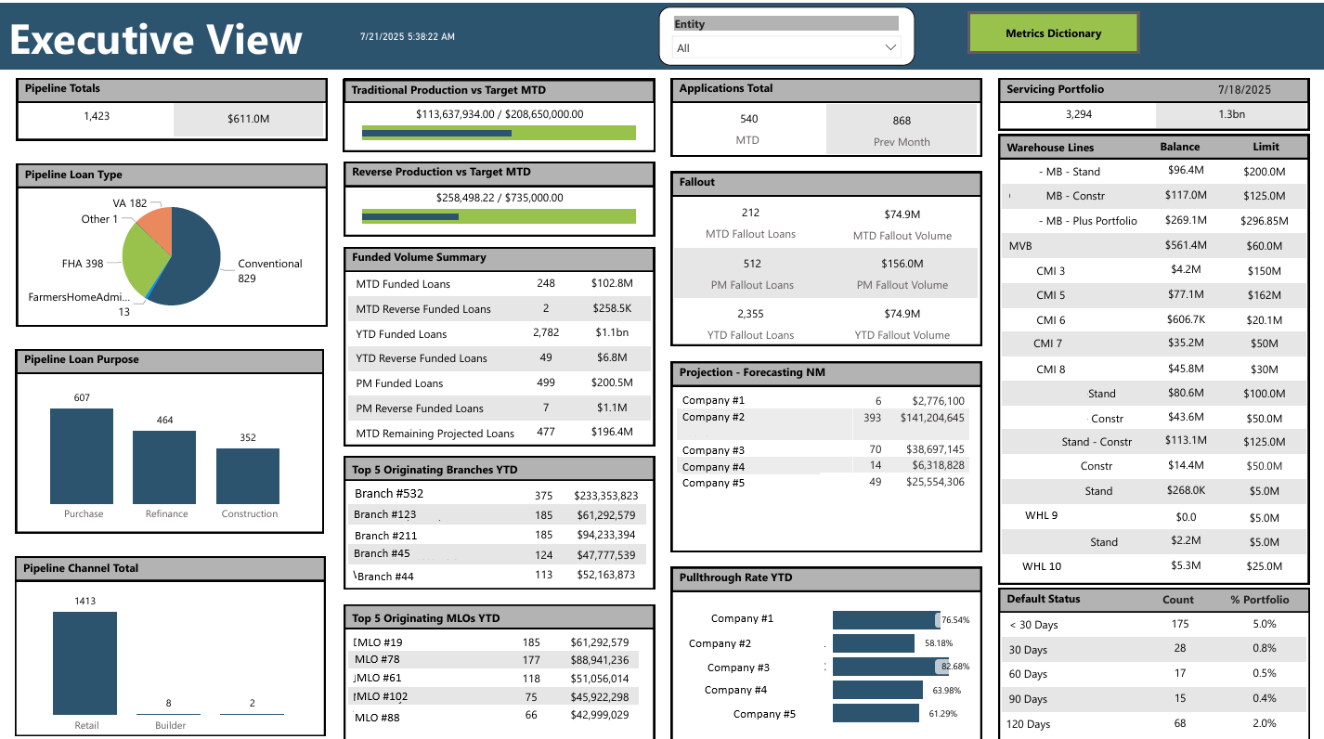
Executive View
Business Need: A dashboard for Execs to track metrics across the organization. Incorporate data from different systems, forecasting, and Production vs goal to be used in weekly/monthly production meetings
Execution: Using Power Query, connected data from various CMS systems and SQL tables storing Warehouse and Servicing data. Wrote DAX calculated columns and measures to support visuals and page filter, and designed the page to neatly fit all the required components in the report.
Impact: This dashboard enabled data-driven strategic decision-making by providing executives a consolidated, real-time view of performance. It improved meeting efficiency by replacing manual compilation with an interactive solution and facilitated proactive performance management through clear Production vs. Goal tracking and integrated forecasting.

Slide 4
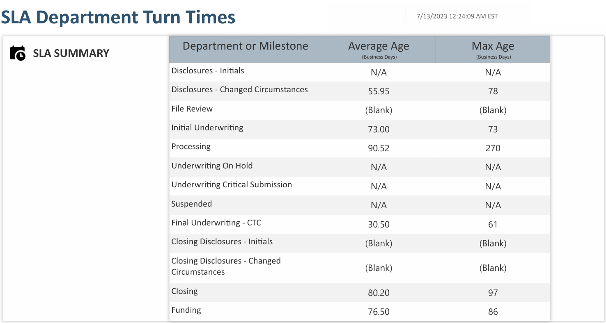
Department SLA Report
Business Need: Business Executives and department managers have strict timelines in which their various tasks need to be done. A report was requested to track the average SLA and single max SLA for various tasks and milestones, encompassing the entire life cycle. Recently, the report needed to be real-time to track up-to-date issues so they could be addressed promptly.
Execution: Using Power Query m and DAX calculated columns and measures, I met with the various department managers to gather their milestones and requirements to track their SLAs, built a pair of measures to handle the differing logic per metric, and built a table-like report with cards and textboxes. Drill through also needed to be configured to get line-level details in order to track down files out of SLA. Eventually, a SQL view was incorporated to handle direct query dataset, and all the logic of the different milestones was moved up into the SQL view to enhance performance.
Impact: This real-time SLA dashboard quickly became the client’s most viewed PowerBI report. It significantly improved operational transparency and accountability across the organization. It empowered executives and managers to proactively identify bottlenecks and address issues promptly, leading to faster task completion times, reduced cycle times, and enhanced overall efficiency in meeting critical timelines.

